Slide 1
Ataxic Neurodegenerative Satiety Deficiency Syndrome
An All Hallows Eve celebration of the brain….

Slide 2
What you need to know, biologically speaking
Steven C. Schlozman, a Harvard neurobiologist on ANSD and the Zombie condition
  http://io9.com/5286145/a-harvard-psychiatrist-explains-zombie-neurobiology
A radio interview with Dr. Schlozman
  http://youtu.be/9lJ4J8_xDOs

Slide 3

What your government wants you to know…
The CDC – yes, that would be the actual United States government Centers for Disease Control – provides the following link to information for surviving the Zombie apocalypse:
http://blogs.cdc.gov/publichealthmatters/2011/05/preparedness-101-zombie-apocalypse/
There are even tee shirts…I kid you not…

Slide 4
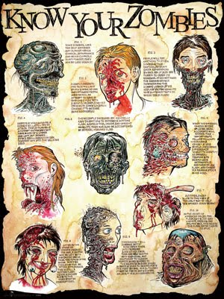
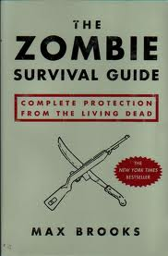
Additional resources

Slide 5
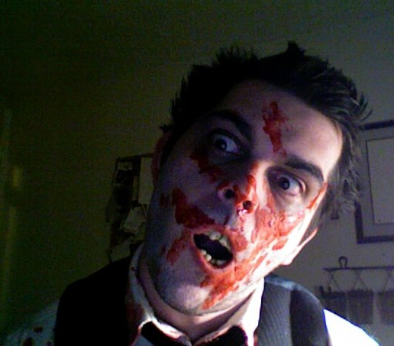

It can happen to you, or someone you love….
A family member of the Instructor
An artistic representation, by the family member, painted so long ago he would consider eating the Instructor’s brain if he knew she was using it…

Slide 6
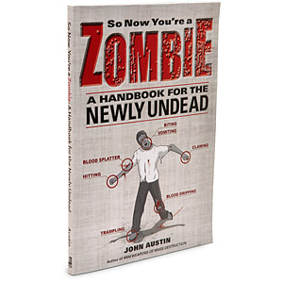
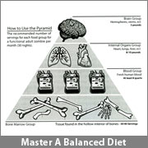
So, if it happens to you…

